Slide 1
Hurricane Iselle (2014)
Hawaii
Analysis

Slide 2
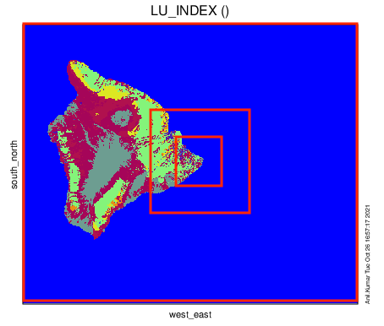
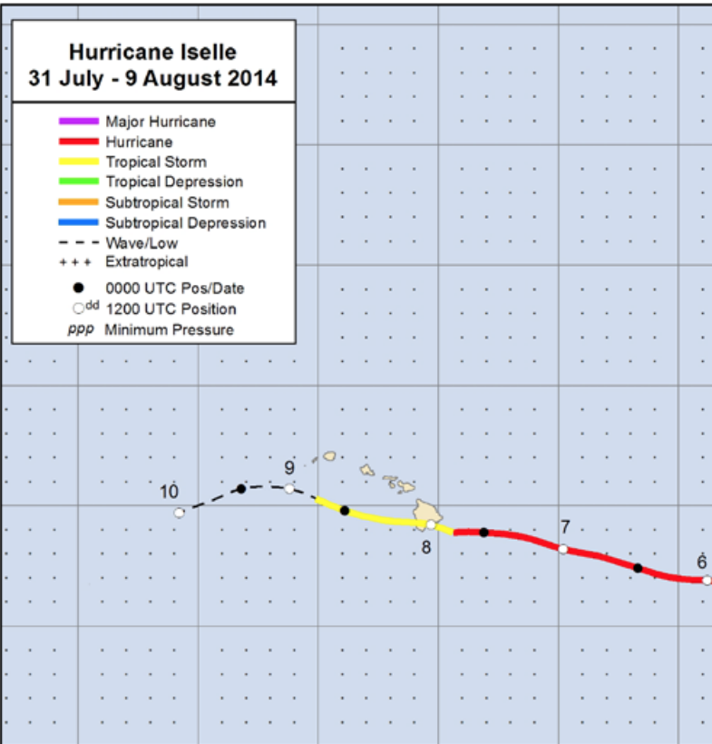
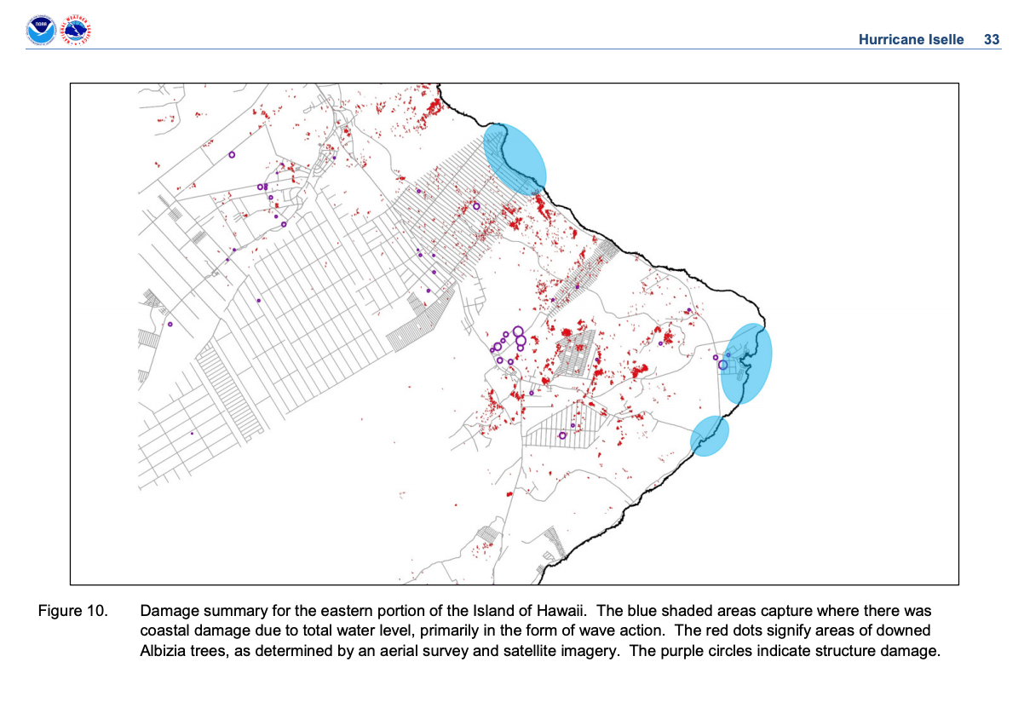
Domain Configuration
DO1
DO2
DO3

Slide 3
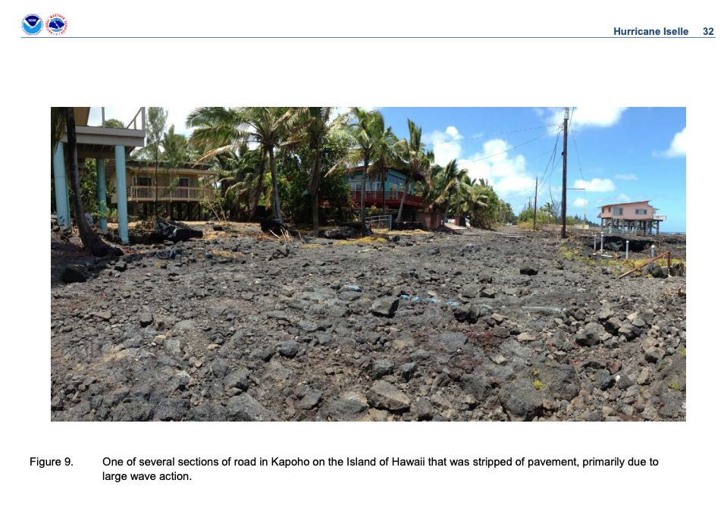
Damage Area

Slide 4
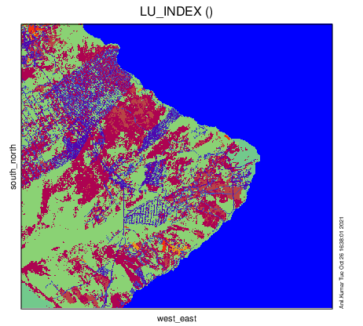
Implemented High-Res Landuse and Elevation

Slide 5
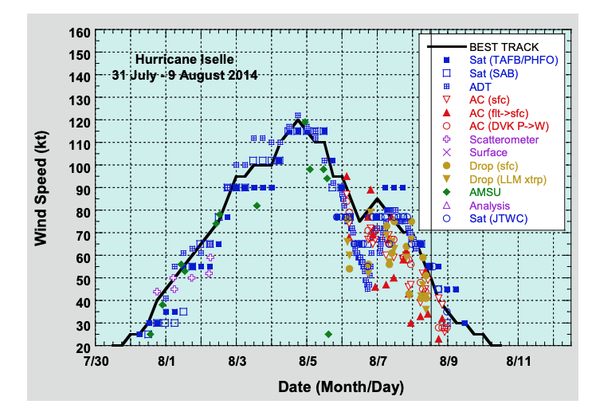
Model Simulation Period
Domain 1 - 0000 UTC 7 - 0600 UTC 9 AUG 2014 (54 hours)
Domain 2 0000 UTC 7 - 0600 UTC 9 AUG 2014 (54 hours)
Domain 3 0000 UTC 8 - 0000 UTC 9 AUG 2014 (24 hours)
Landfall
1200 UTC 8 Aug

Slide 6
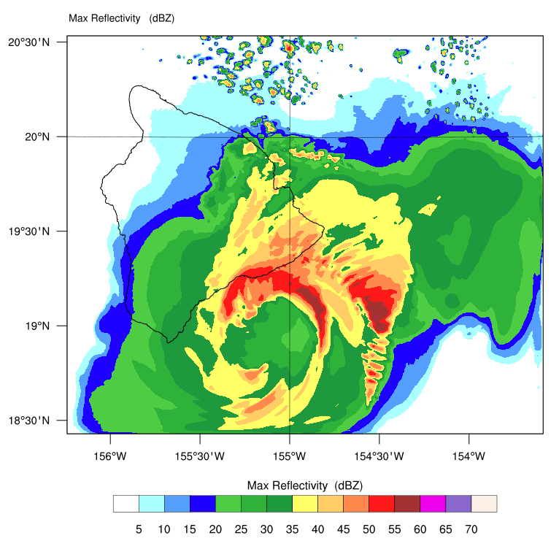
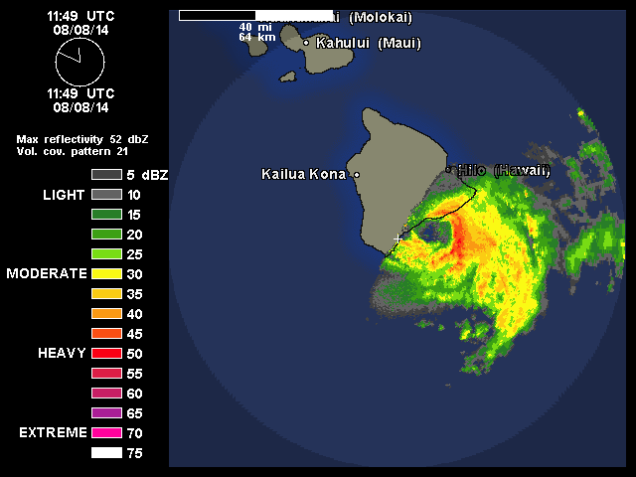
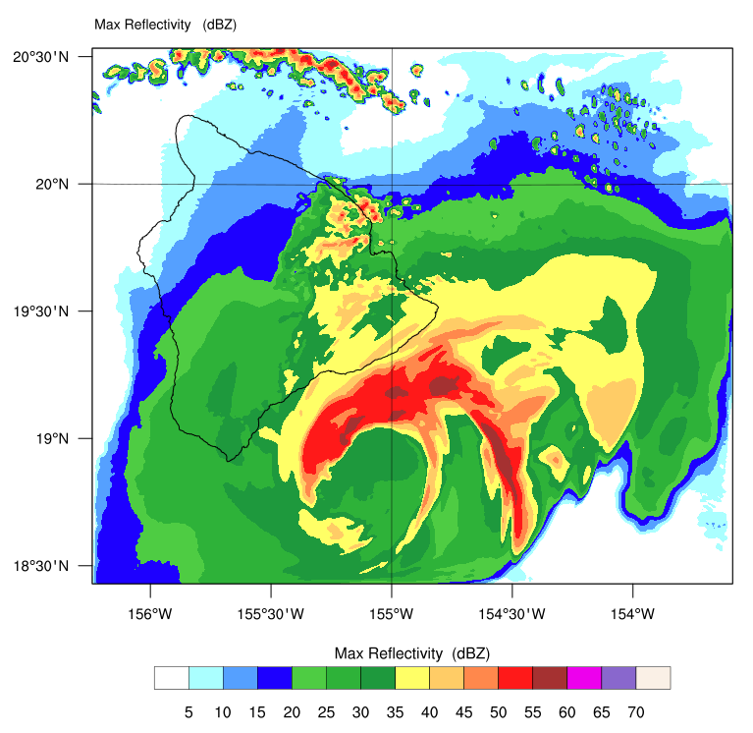
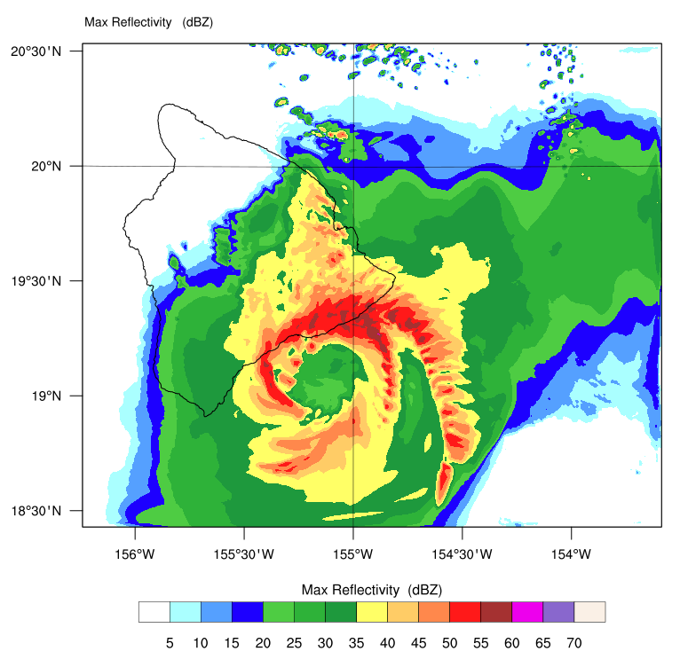
Radar Reflectivity
12:48 UTC 8 Aug
11:49 UTC 8 Aug
11:48 UTC 8 Aug
13:48 UTC 8 Aug
1 - 2 hour lag in the Model

Slide 7
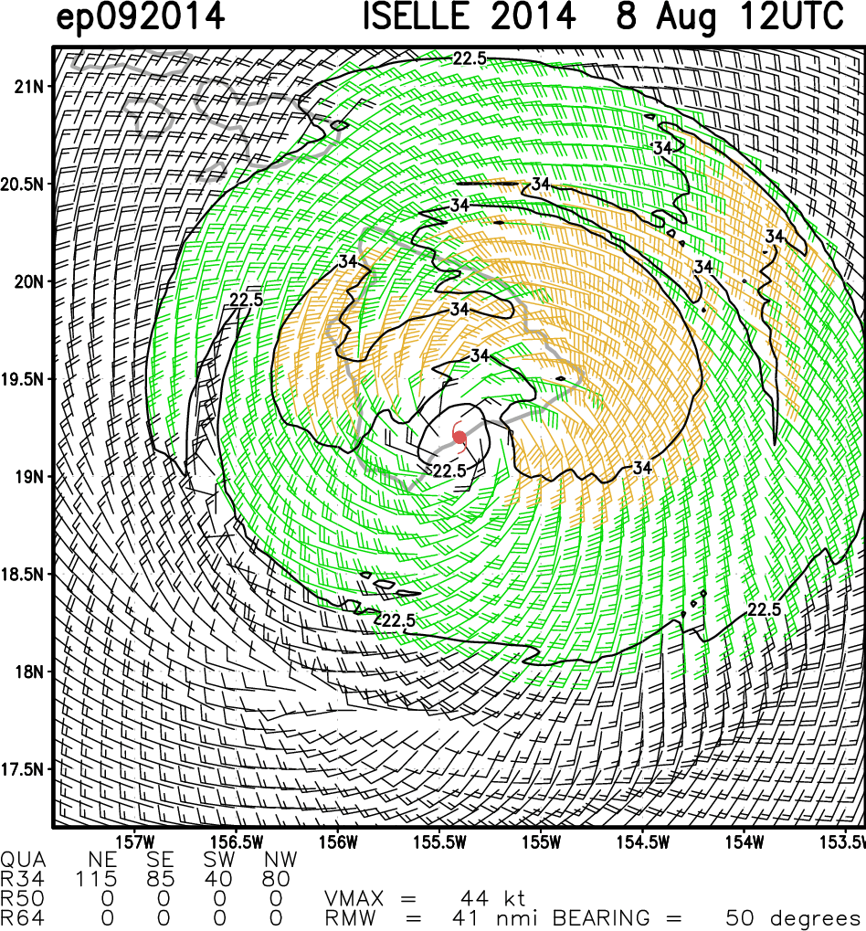
Surface Wind Speed
Satellite based surface wind speed not looks reasonable over Hawaii Island
50 kts wind speed observed during landfall

Slide 8
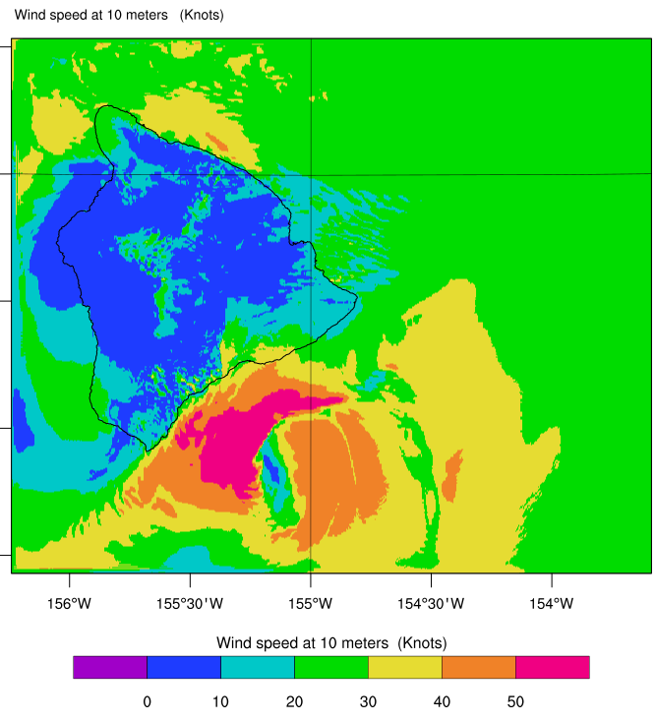
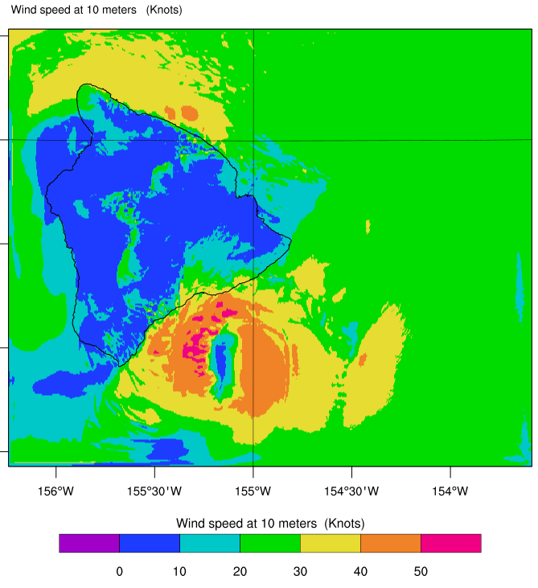
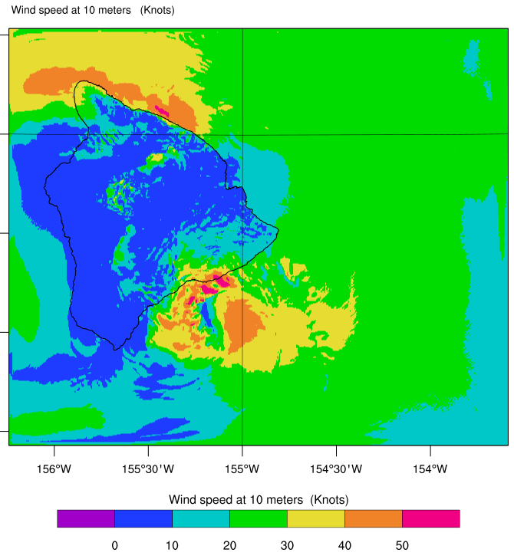
Surface Wind Speed
LES OUTPUT Domain 1
1148 UTC
1248 UTC
1348 UTC

Slide 9
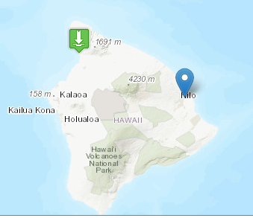
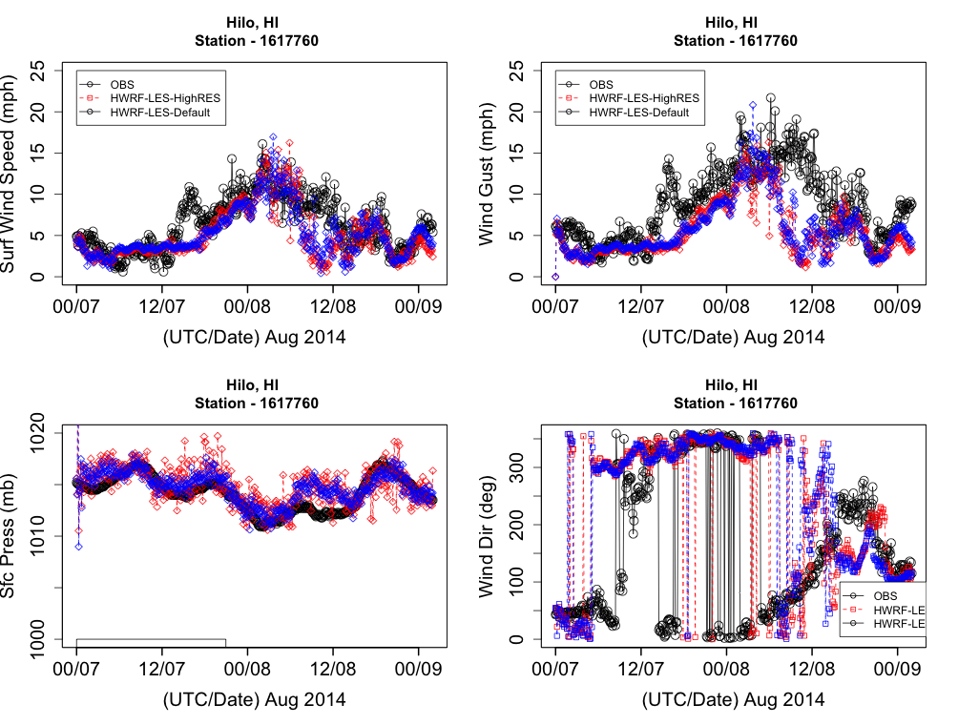
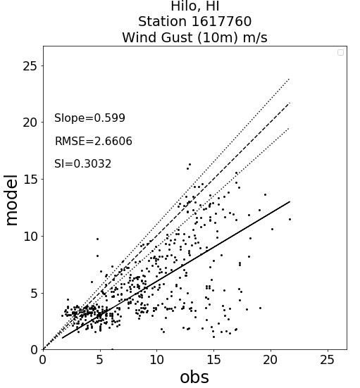
Observation Station based Verification

Slide 10
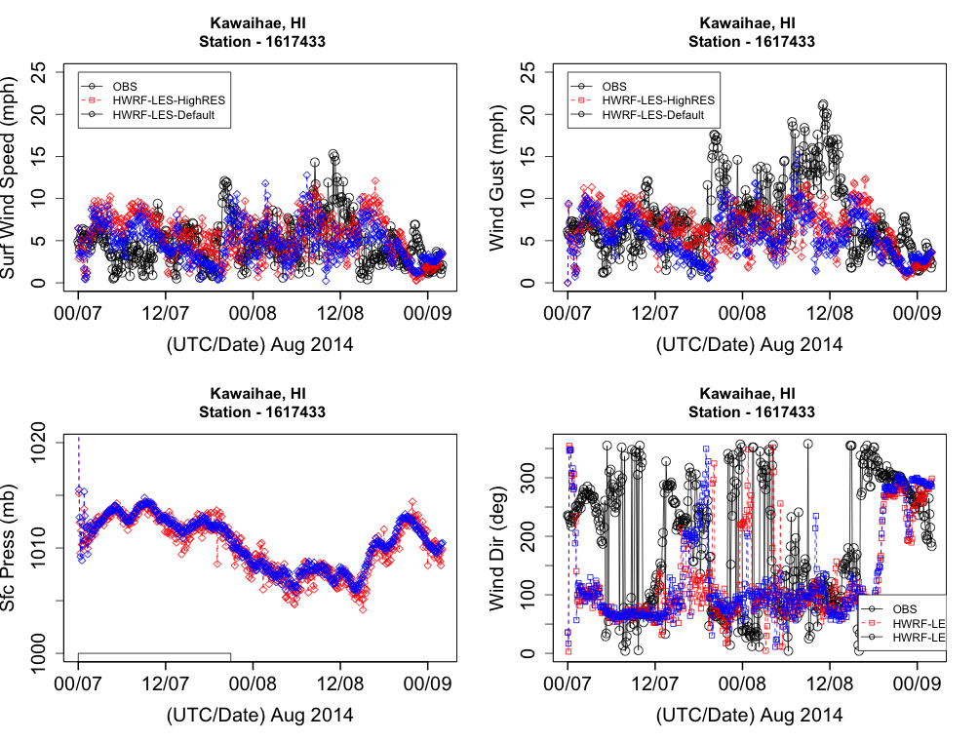
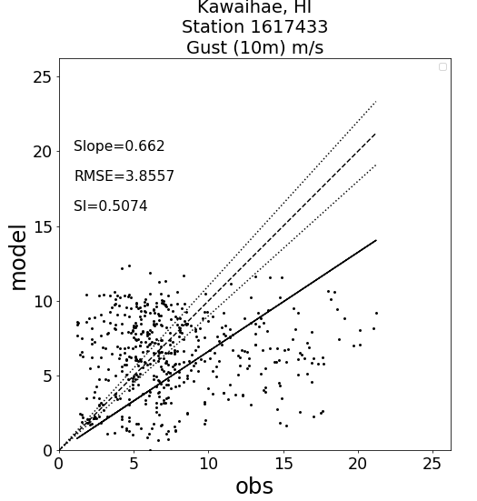
Observation Station based Verification

Slide 11
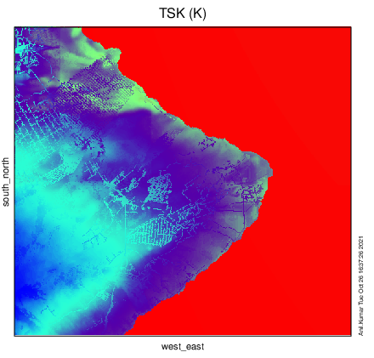
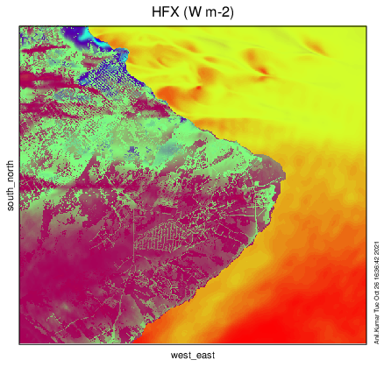
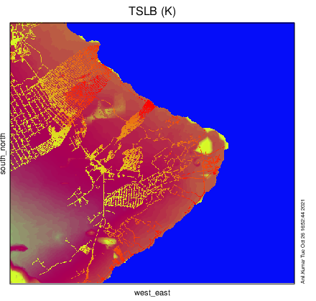
High Resolution impact

